Slide 1
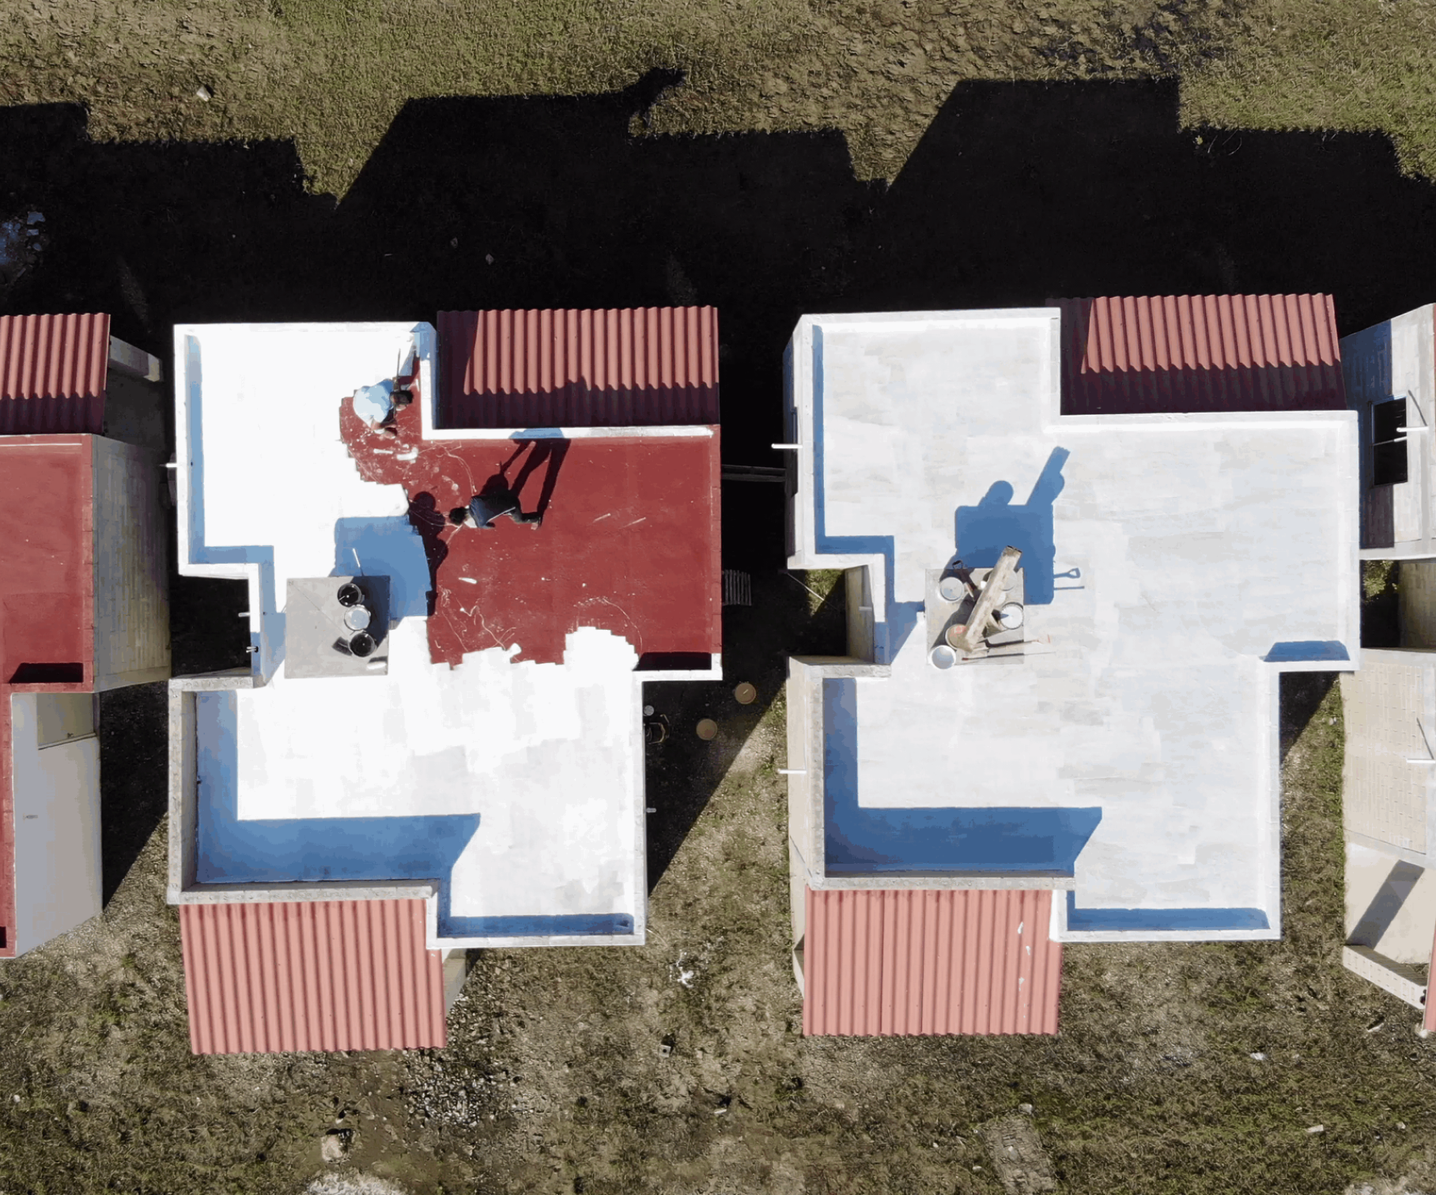
Cool Roofs Toolkit Design and Development
By Andrew Nguyen

Slide 2
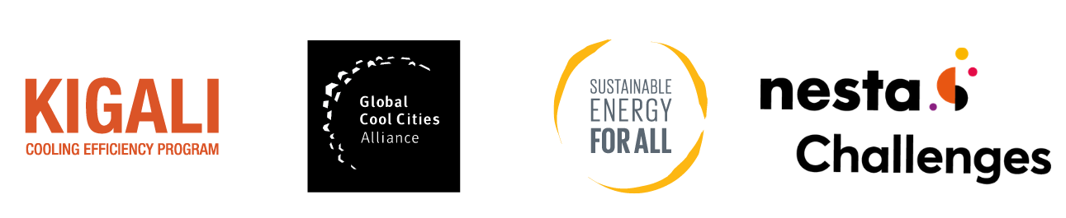
Project BACKGROUND
The Arup ADE team was asked to design, scope and develop a public-facing repository of information for work done by the community engagement team for the Million Cool Roofs Challenge.

Slide 3
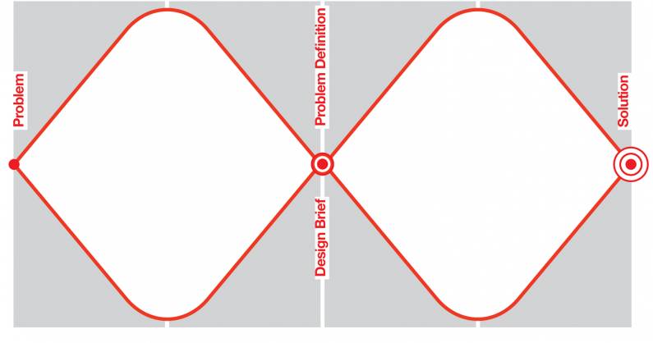
Process

Slide 4
Discovering the problem space

Slide 5
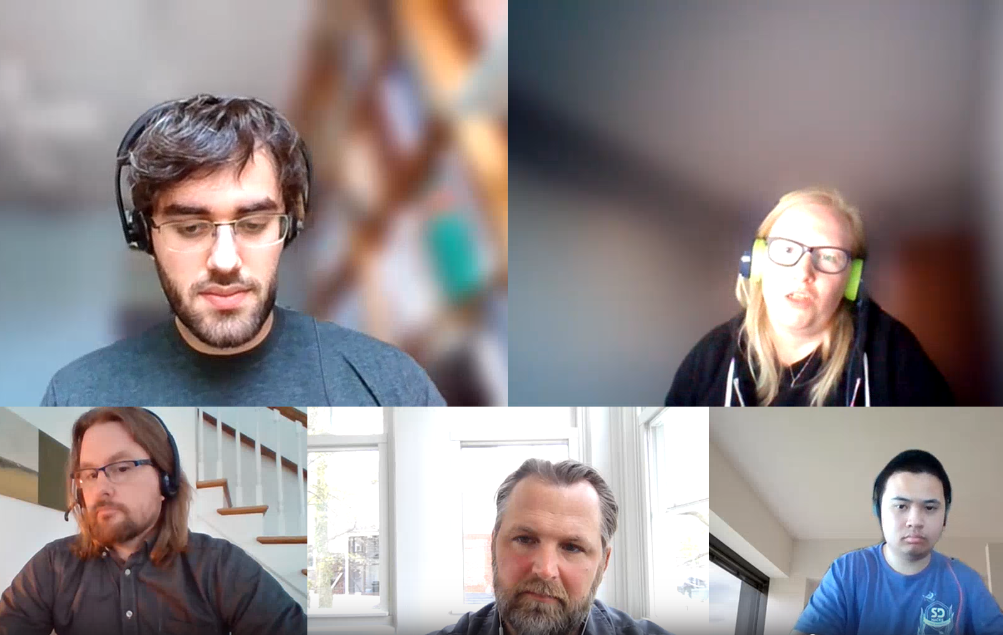
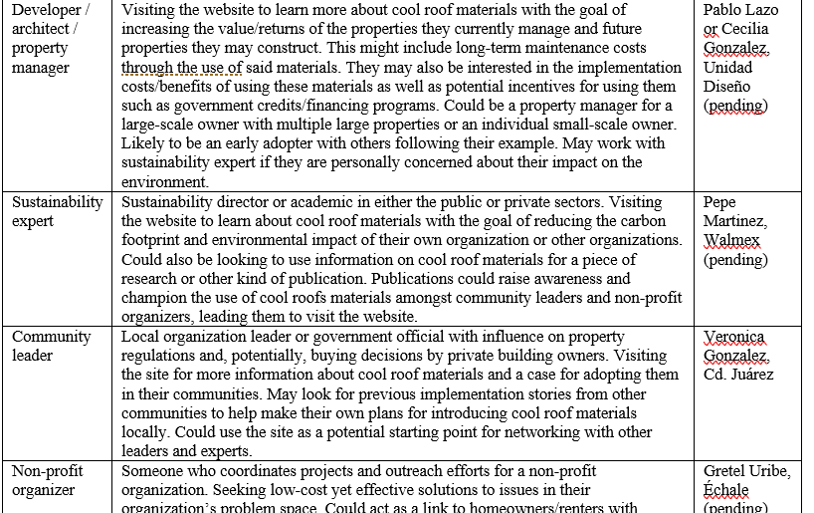
Initial onboarding and Generating Assumptions

Slide 6
Defining our users

Slide 7
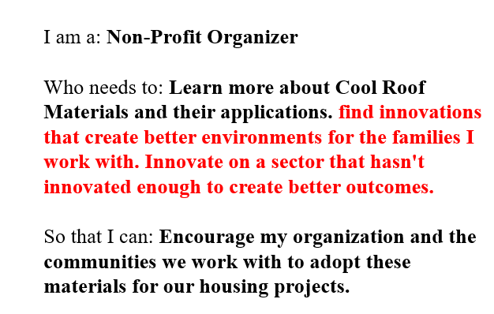
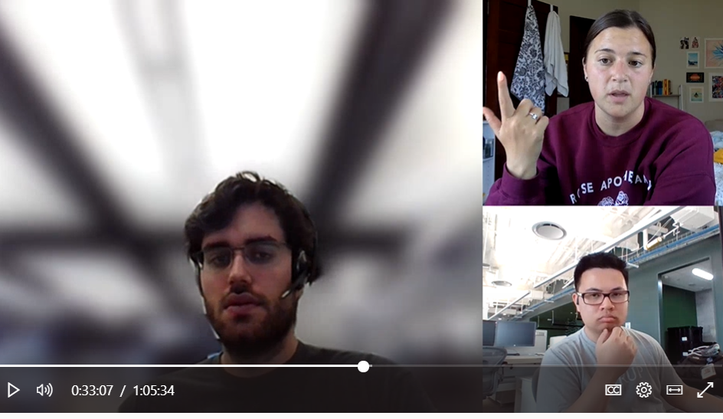
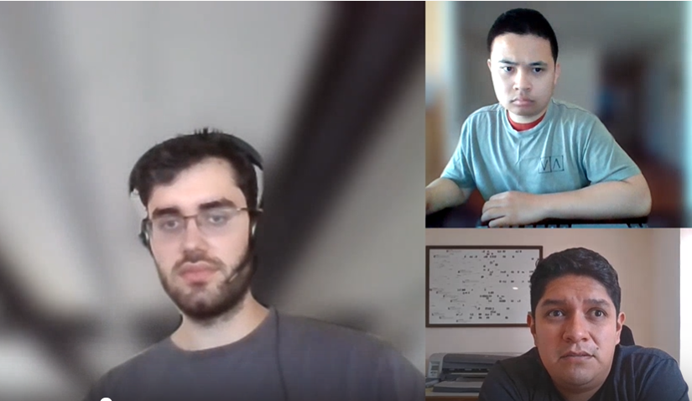
Stakeholder interviews and user Stories

Slide 8
developing the design

Slide 9
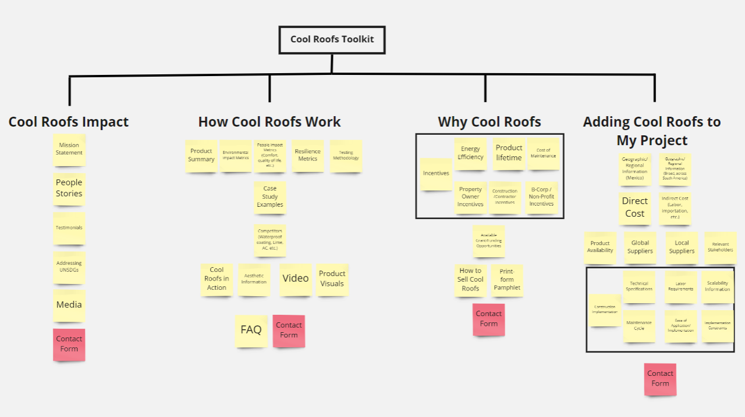
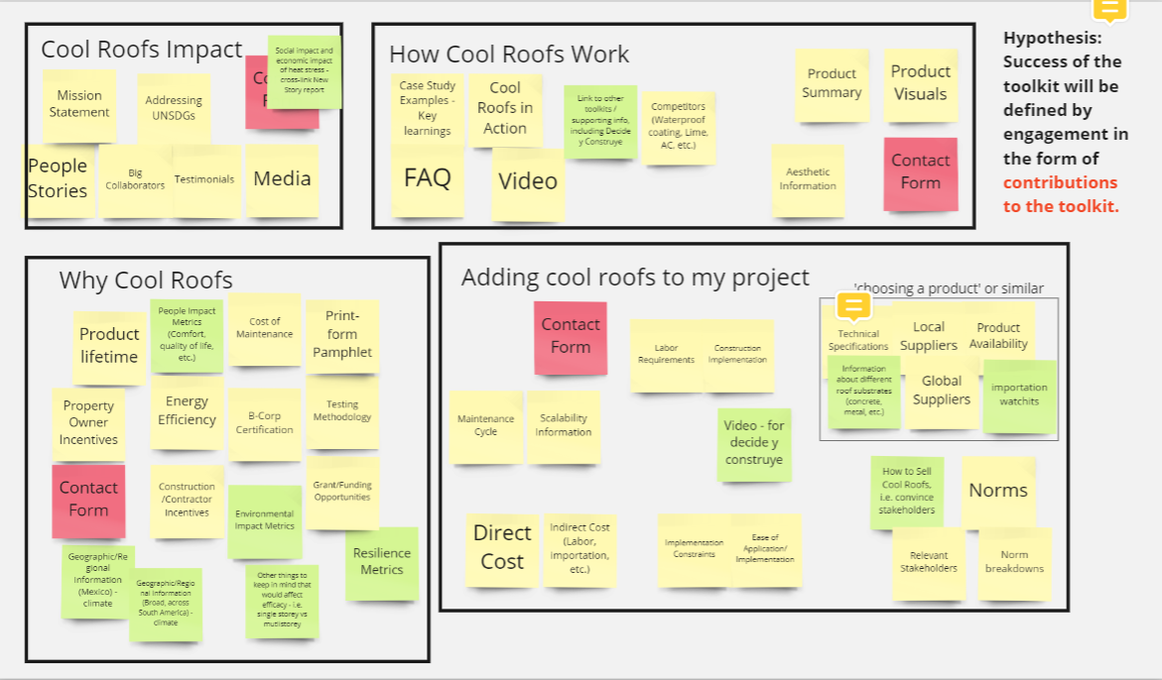
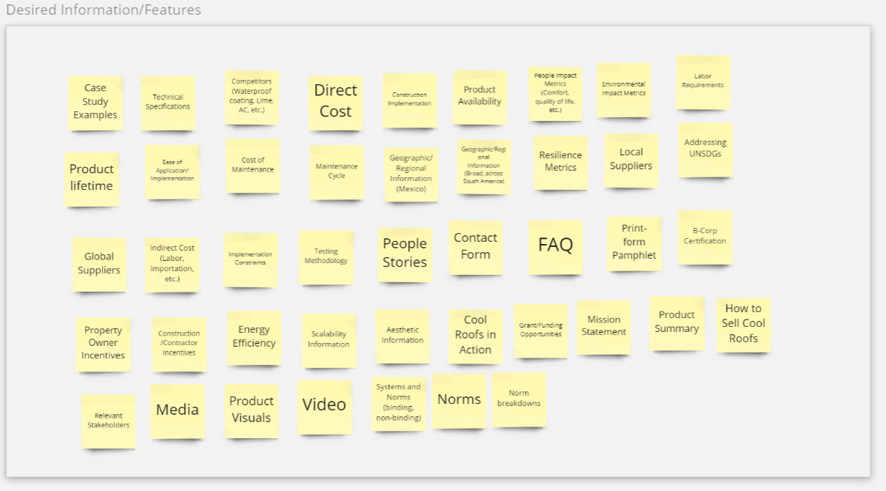
Initial design and Information Architecture workshop

Slide 10
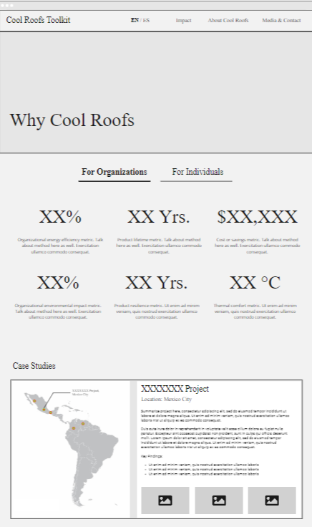
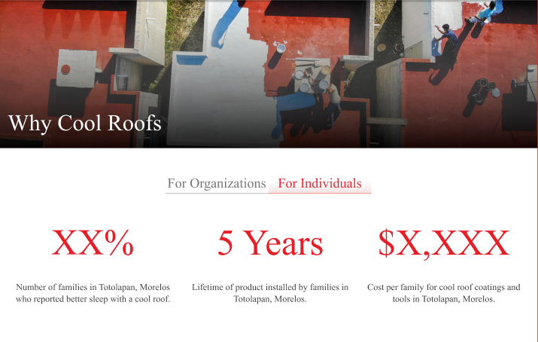
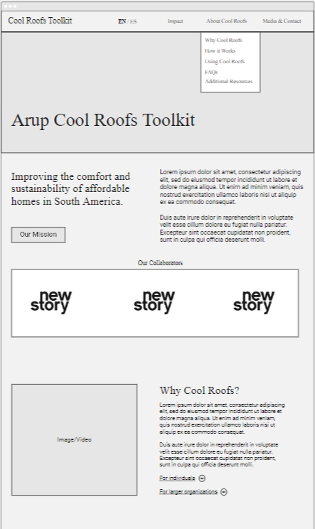
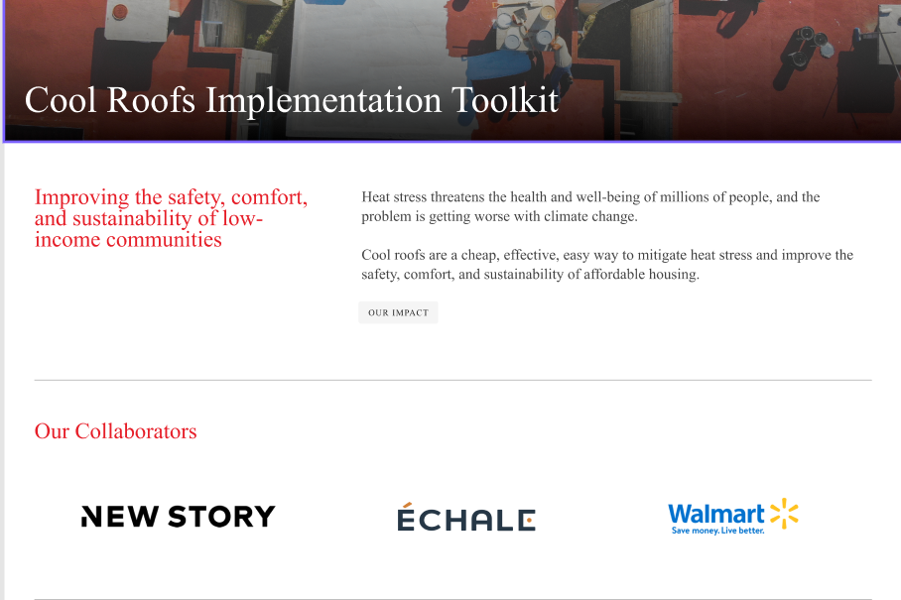
Wireframes and interactive mockup

Slide 11
Delivering the solution

Slide 12
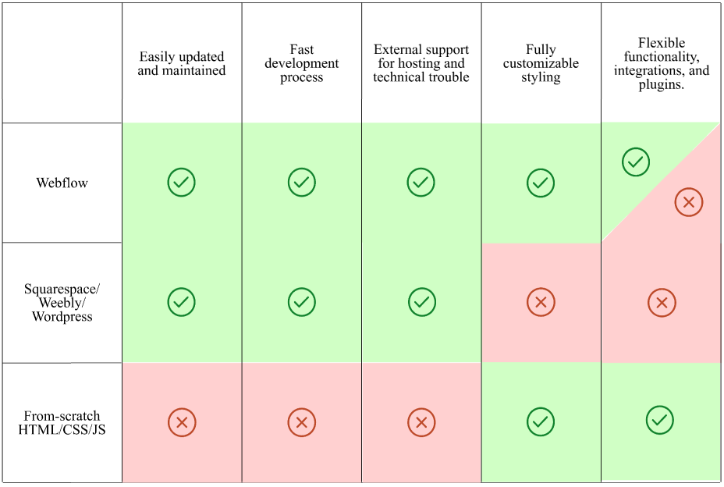
Why Webflow?

Slide 13
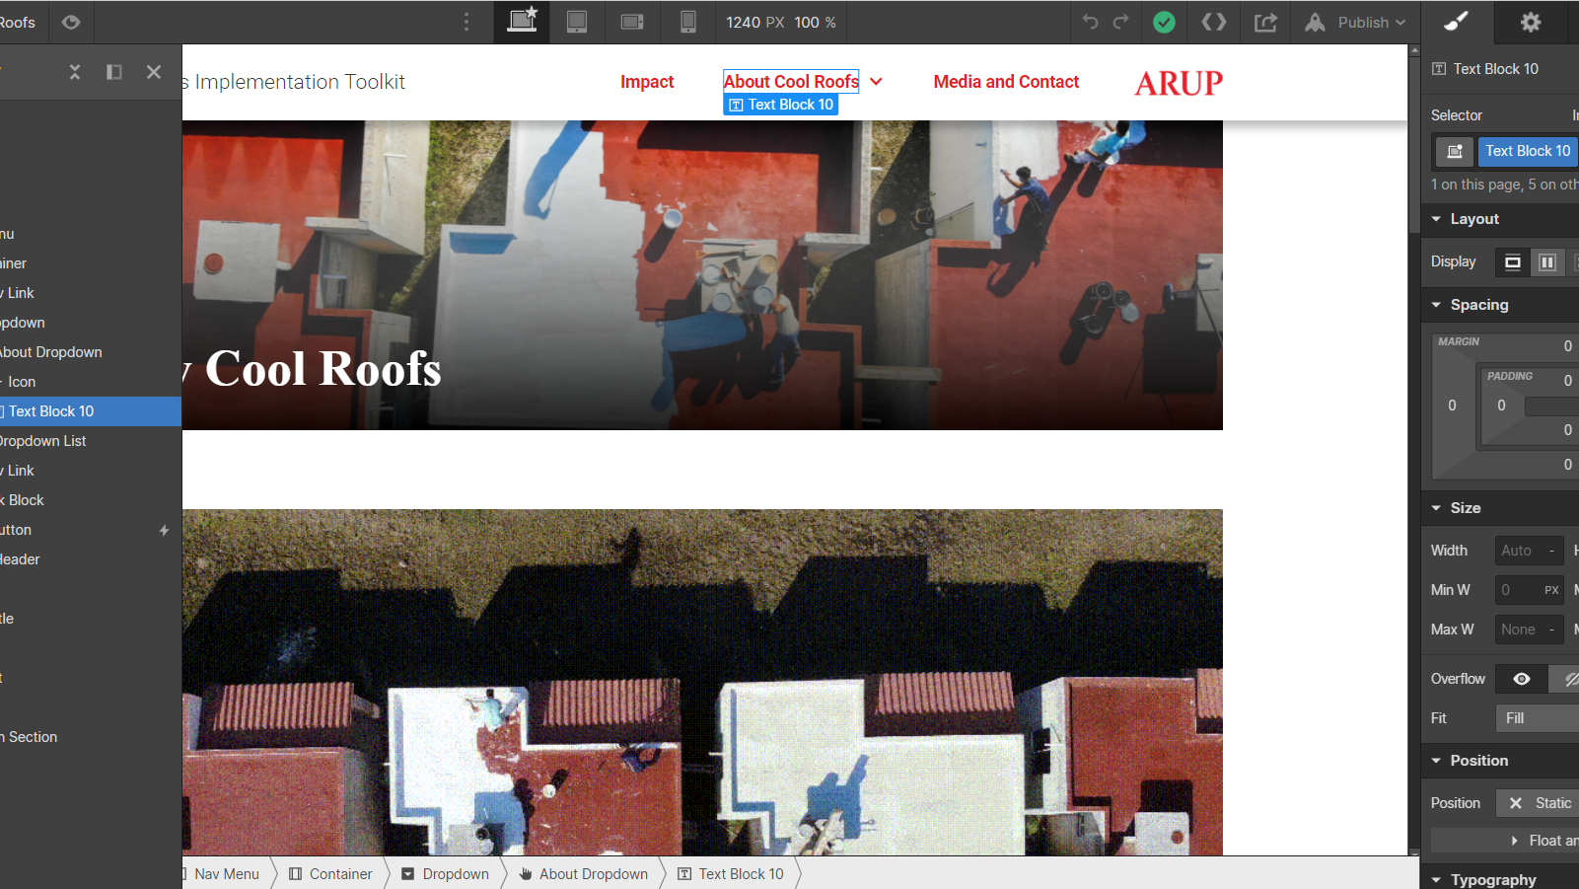
Site and webflow walkthrough https://cool-roofs-toolkit.webflow.io/

Slide 14
Successes and Lessons Learned
Successes:
Derived key insights and understanding of feature requirements
User engagement helped internal Arup stakeholders better understand user needs
Developed and refined a hypothesis to measure the project’s success
Process allowed for constant incremental iteration from concept to prototype
Showcased the potential value design can have on a project
Lessons Learned:
Some external stakeholders are difficult to reach due to availability
More content design should be done upfront for a public-facing project
Ensure that any interviews are recorded for future reference.
Not every solution requires a from-scratch solution
Dread it, run from it, DT still arrives…

Slide 15
Comments, questions, feedback?
For more info reach out to: Andrew Nguyen or Adam Jaffe

